Slide 1


Expert Hacks:
Data Science from the lens of an expert
Anish Mahapatra | 07 May, 2022

Slide 2

Agenda
01
Introduction
02
Motivation to do an MSc
03
How to leverage an MSc in the current market?
04
Is Master’s degree required?
05
Tools & Technologies, Job strategies and CTC
06
Let’s Talk!

Slide 3











Topic 1 of 6
Introduction
Senior Data Scientist
LinkedIn: www.linkedin.com/in/anishmahapatra Medium: anishmahapatra.medium.com Website: www.anishmahapatra.com
GitHub: www.github.com/anishmahapatra
Q. How to get into Data Science?
A. Simple, ask a real-world Data Scientist.
PGD – 3.9/4 || MSc with Distinction

Slide 4




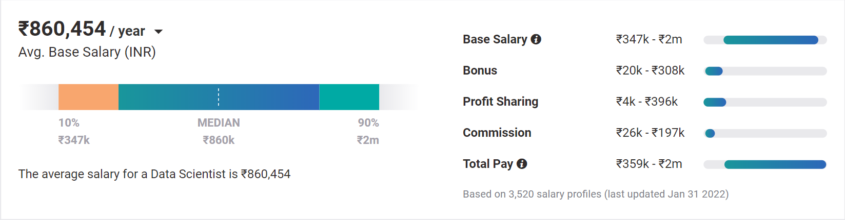
Topic 2 of 6
Motivation to do an MSc
01
02
03
Relevance in the future
Business & Technology
Industry-Agnostic & Senior Positions
Companies are building and growing in Data and it is the future & exposure to the industry
Data Science is a combination of Business, Math and Technology, so growth can be in business / technology
Use your existing knowledge / domain / technology expertise with a data-edge
04
Extremely High Market Demand (+38%)
Supply-Demand mismatch means companies are willing to pay more
Notes:
Source:https://www.payscale.com/research/IN/Job=Data_Scientist/Salary

Slide 5
Topic 4 of 6
How to leverage Master’s Degree?
01
02
03
Set Target
Talk to people
Build LinkedIn Profile
Understand the Data Field,
Understand roles & responsibilities,
Look at a 5-year path
Talk to people who are already doing what you want to do
Add certifications, participate in competitions, do simple projects, look at how the best of the best do it
06
05
04
Build Collaterals & Profile (30%)
Globally Accepted Degree (70%)
Explore Certifications
Multiple certifications don’t help, the quality of it does.
GitHub, LinkedIn,
Medium, Brand Profiling
Globally recognized degree, Degree Accepted by MNCs,
Possibility of PhD later,
Alumni Status
Bonus - WES Certification, Teachers from the industry
Notes:
Source: https://databricks.com/blog/2020/08/20/modern-industrial-iot-analytics-on-azure-part-3.html

Slide 6

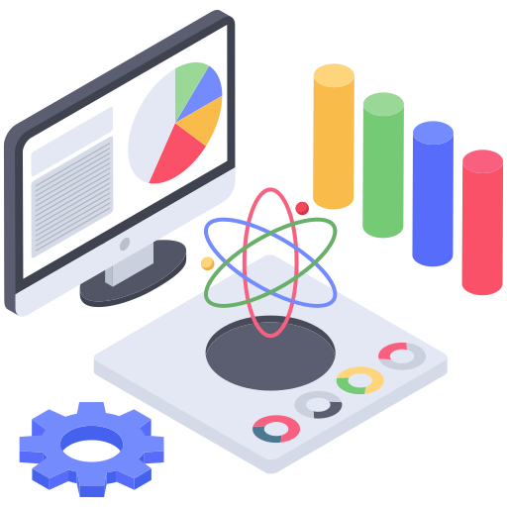


Topic 3 of 6
Is Master’s Degree required?
Globally Accepted Master’s Degree
WES Certification
Accepted by MNCs across the Globe
Globally accepted to clear any filter of MSc Degree
Amazon, Google, Facebook, Microsoft
Potential to do PhD in the future
Accepted by any country that otherwise would have accepted an offline degree from the UK

Slide 7
Topic 3 of 6
The end to end process
01
02
03
Chose a dataset
Propose three
Research topics
Get a Thesis Supervisor
Select the dataset,
Find papers in the last two years,
Find code, if possible,
Leverage Kaggle
Leverage your thesis supervisor, they are experts. You have the freedom to work at your pace.
Select three topics you would be comfortable to do in 1.5 months
06
05
04
Final Submission & Video Presentation
Mid-Thesis Report
Research Proposal
How to do research in a way that is going to help your final grade and score?
How to most efficiently pitch and plan for the topic that you have chosen

Slide 8








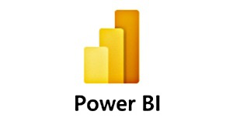




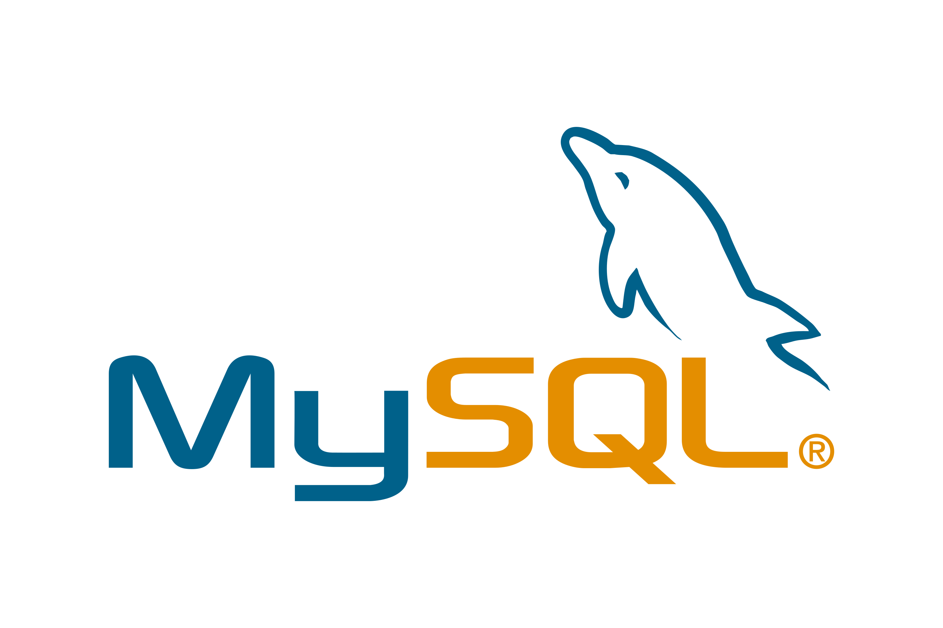
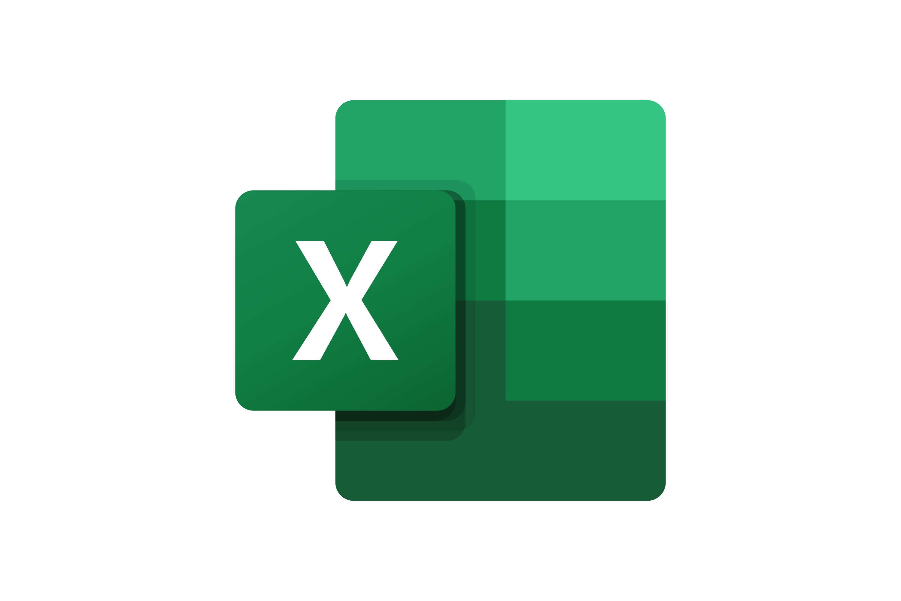
Topic 5 of 6
Tools & Technologies in Data Science
Data Engineer
Machine Learning Engineer
Business Analyst
Data Scientist

Slide 9






Topic 5 of 6
Resume Optimization & Paper Walkthrough

Slide 10
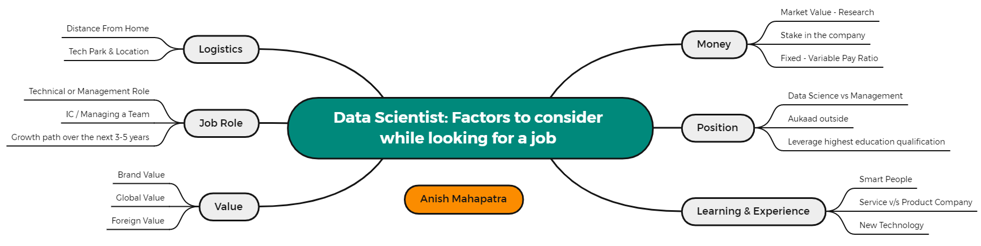
Topic 5 of 6
Factors to consider while looking for a job

Slide 11
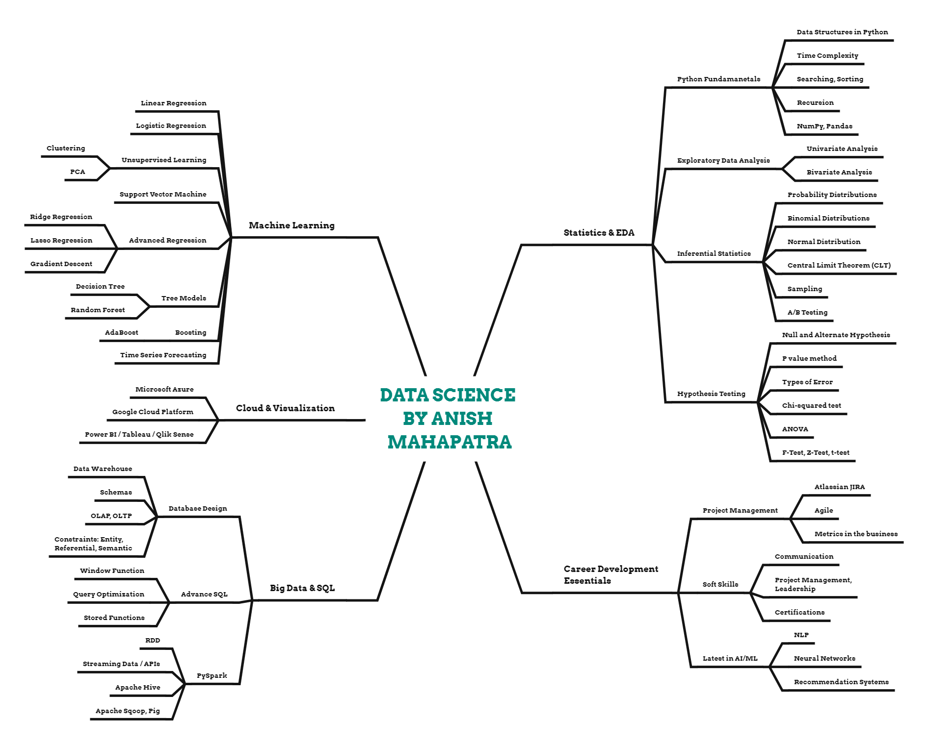
Topic 5 of 6
Plan your Data Science prep

Slide 12
Key Takeaways
01
Introduction
02
Motivation to do an MSc
03
How to leverage an MSc in the current market?
04
Is Master’s degree required?
05
Tools & Technologies, Job strategies and CTC
06
Let’s Talk!

Slide 13

Evolving research & its importance in the Tech Industry
Anish Mahapatra
Let’s Talk!
LinkedIn: www.linkedin.com/in/anishmahapatra
Email: anishmahapatra01@gmail.com

Slide 14

Evolving research & its importance in the Tech Industry
Anish Mahapatra | 20 November, 2021
Q. How to get into Data Science?
A. Simple, ask a real-world Data Scientist.
Email: anishmahapatra01@gmail.com
Thank you.

